Slide 1

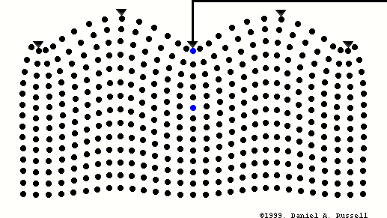




Near-surface characterization and S-wave statics:
Bradford 3D-3C seismic survey (Marcellus shale)
Daniel A. Russell (1999)
Soumya Roy
Advisor: Dr. Robert R. Stewart
AGL Annual Meeting, Houston, TX
16th May, 2013

Slide 2
Overview
Motivation and objective
- Near-surface characterization
S-wave velocities (from surface-wave inversion)
- La Marque, TX - YBRA field camp, MO
- Meteor crater, AZ
Bradford survey, Pennsylvania (Data courtesy: GeoKinetics)
- 3D-3C seismic survey - S-wave statics
Limitations and developments
  - Lateral heterogeneity - Full-waveform inversion
Summary

Slide 3
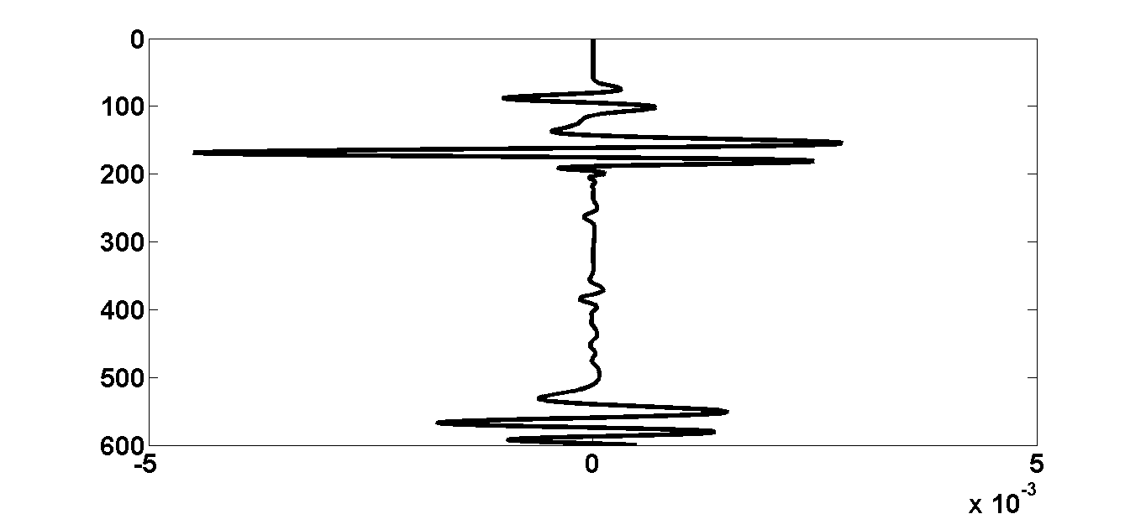
Motivation And Objective
To provide near-surface solution for multicomponent seismic analysis
To develop a non-invasive, inexpensive, and fast method to estimate 2D (and 3D) shallow-subsurface material properties
S-wave velocities from surface-wave inversion
- To identify shallow geological structures
- To correct for time delays in seismic waves (statics)
- To predict densities
- Full-waveform inversion (FWI)

Slide 4
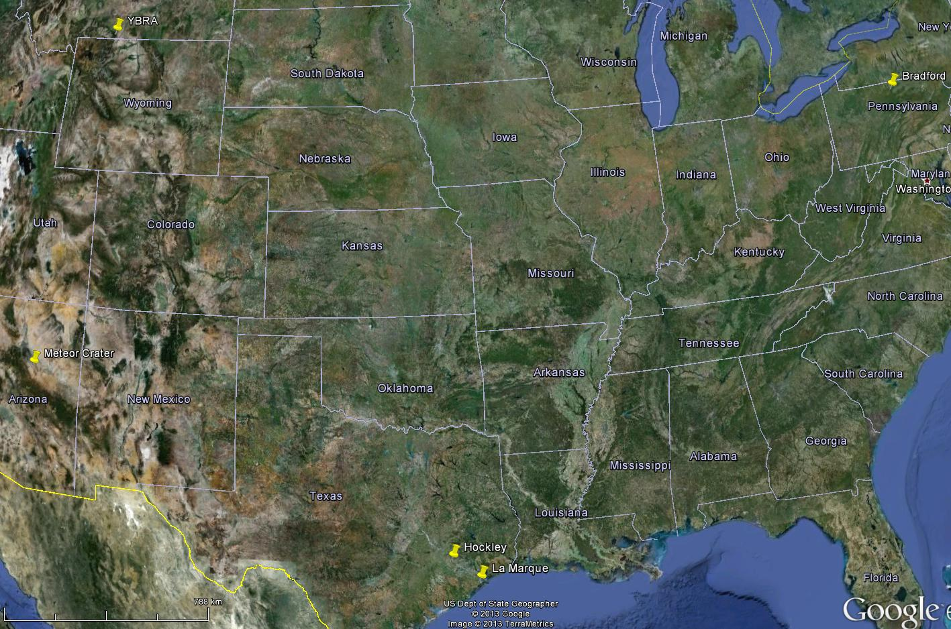
Survey Locations
YBRA Field Camp
2. YBRA Field Camp, MT
4. Bradford, PA
Bradford
Meteor Crater
Meteor Crater
3. Meteor Crater, AZ
Hockley
0
788
0
788
Km
1. La Marque, TX
Km
La Marque

Slide 5

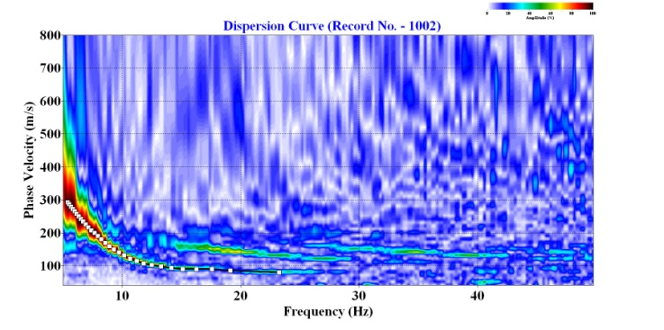
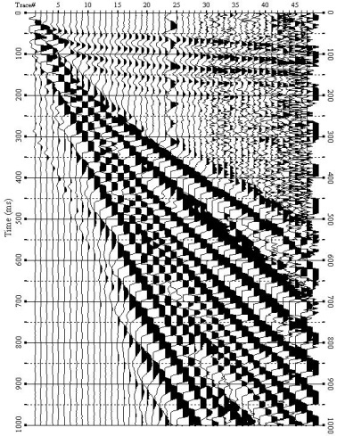
Surface-wave Inversion: MASW
Multichannel Analysis of Surface Waves (MASW)
Dispersion Curve
0
Amplitude (%)
100
Offset (m)
0
94
700
0
Phase velocity (m/s)
500
Fundamental Modes
t (ms)
Higher Modes
300
100
10
20
30
40
…
Frequency (Hz)
1000
S1
Sn
Seismic Data: La Marque, TX
…
(Park et al., 1998; ibid 1999; Xia et al., 1999)

Slide 6
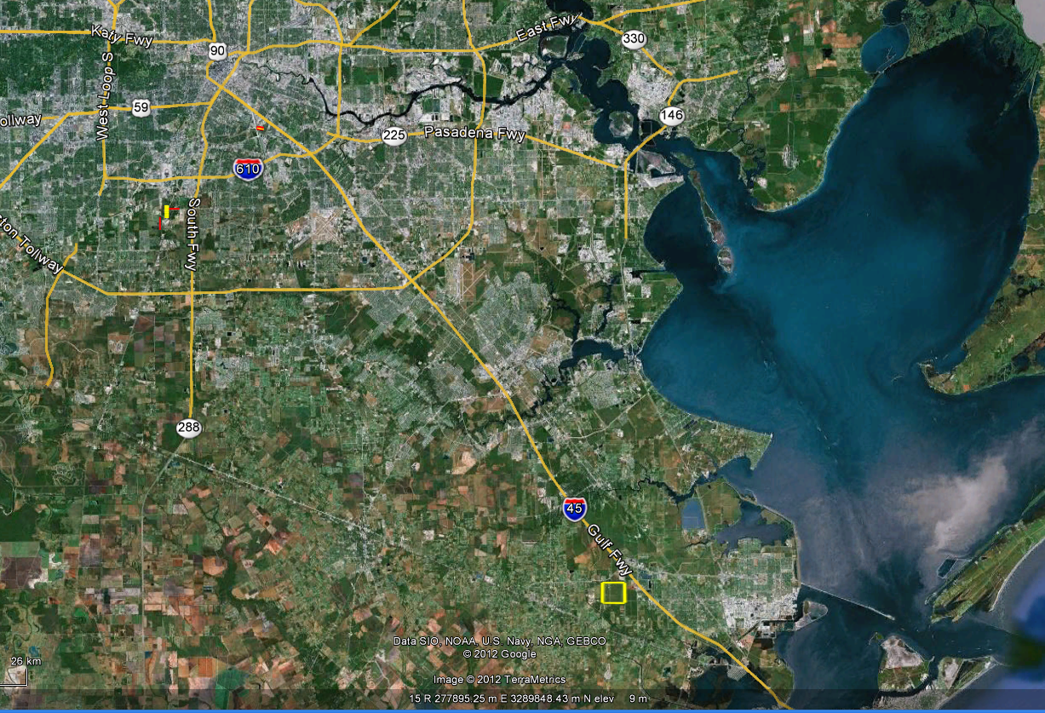
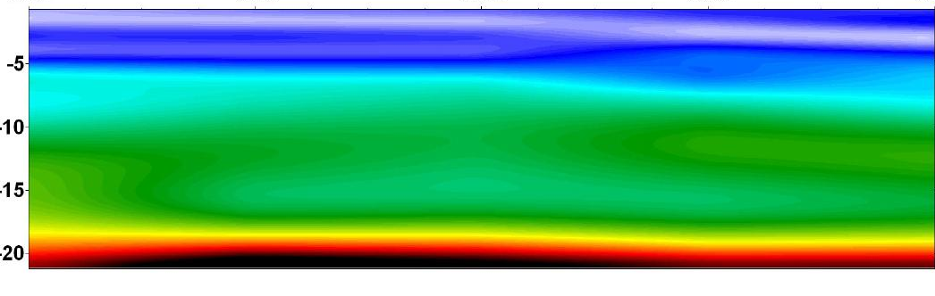
S-wave Velocities: La Marque
Source interval: 2 m
Receiver interval: 2 m
UH
La Marque, TX
100
200
300
400
S-wave Velocity (m/s)
44
46
48
50
52
5
10
Depth (m)
15
20
Distance (m)

Slide 7
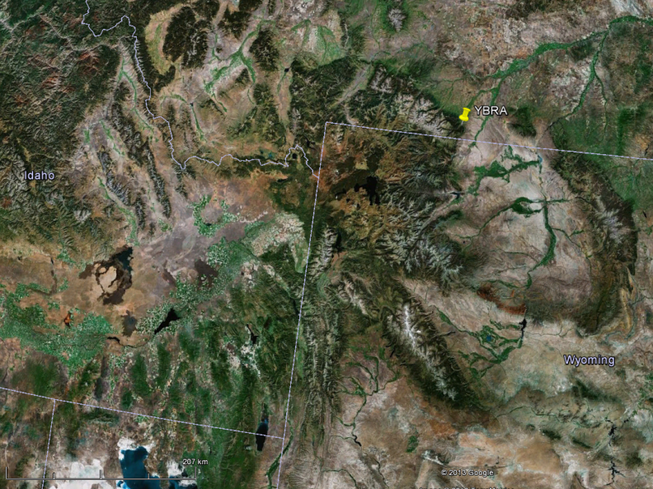
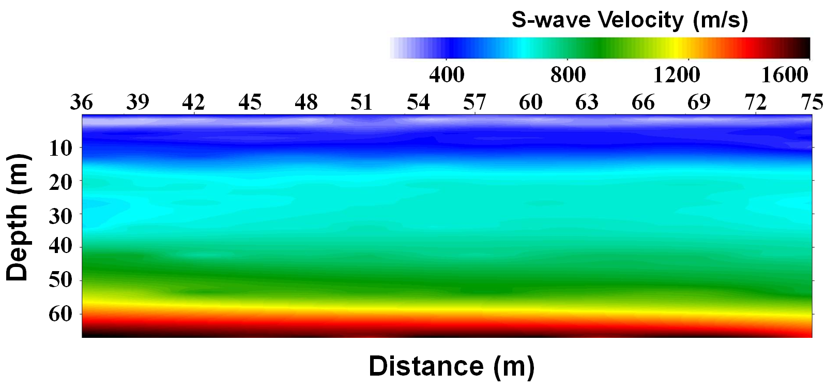
S-wave Velocities: YBRA
Montana
Source interval: 3 m
Receiver interval: 3 m
YBRA
Idaho
Wyoming

Slide 8
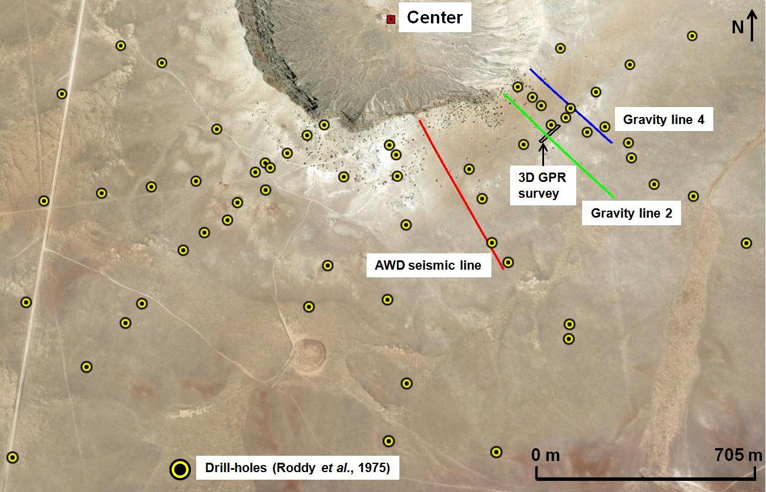
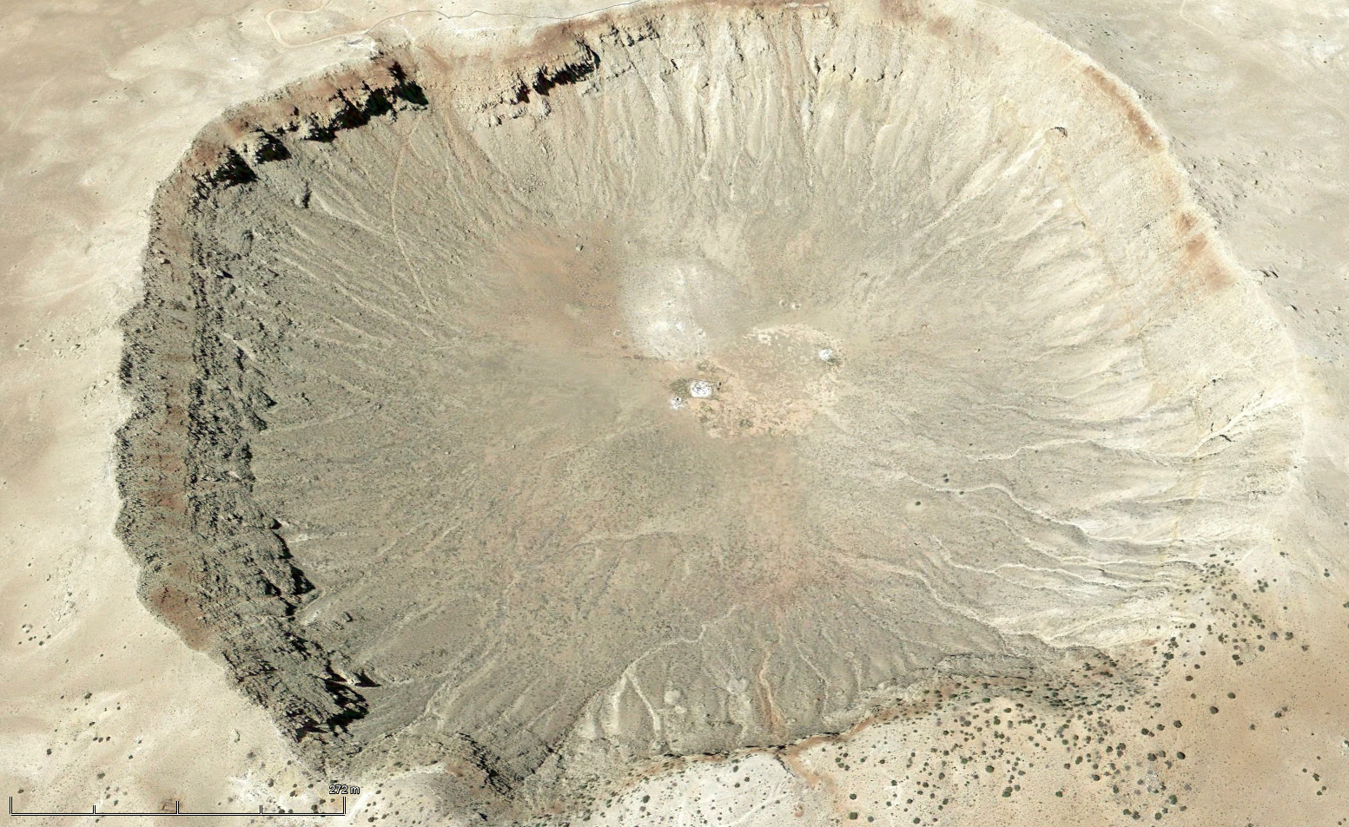
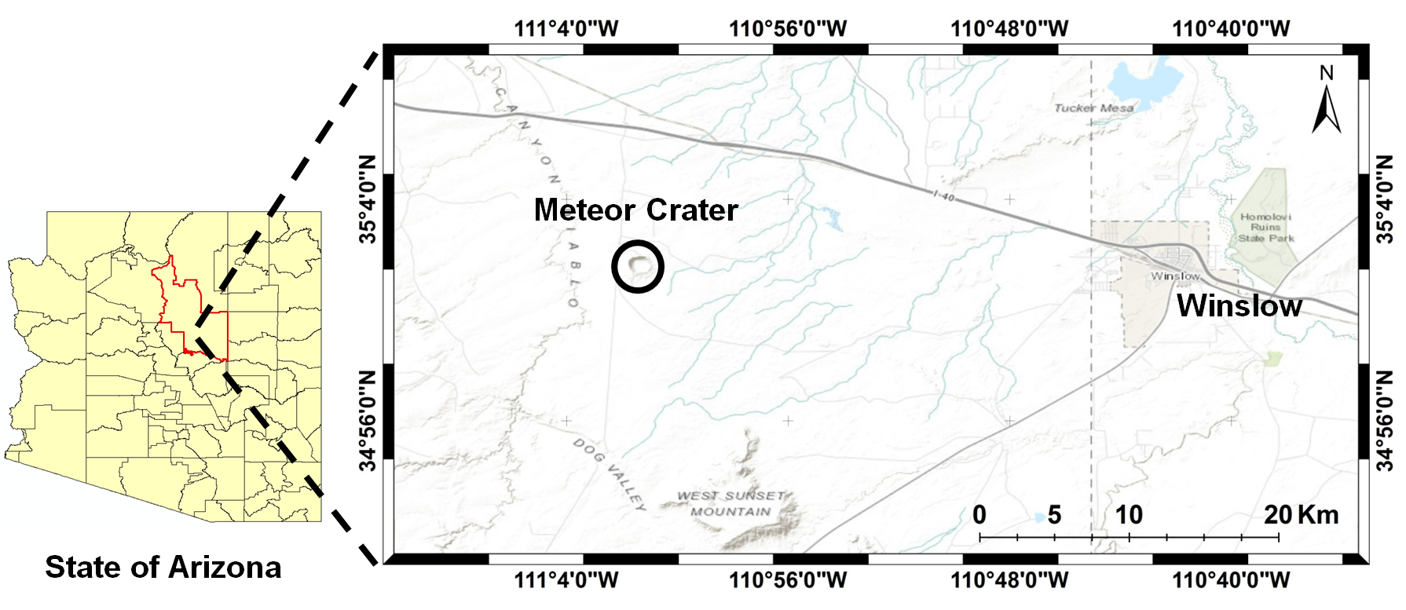
Barringer (Meteor) Crater, Arizona
Crater rim
Bowl-shaped depression
0
m
272

Slide 9
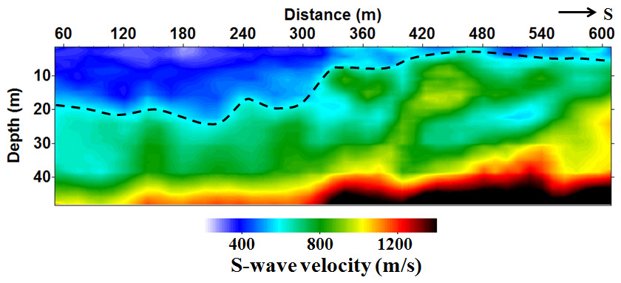
S-wave Velocities: Meteor Crater
Source interval: 3 m
Receiver interval: 3 m
Roy, S. and R. R. Stewart, 2012, Near-surface seismic investigation of Barringer (Meteor) Crater, Arizona, Journal of
Environmental and Engineering Geophysics, 17, 117-127

Slide 10
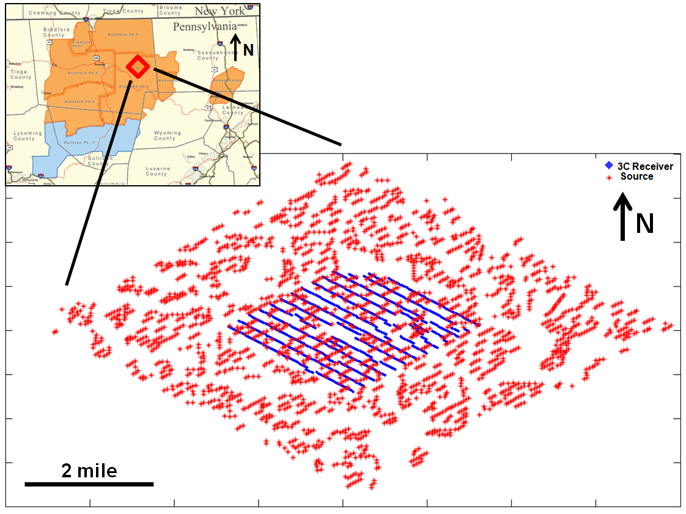
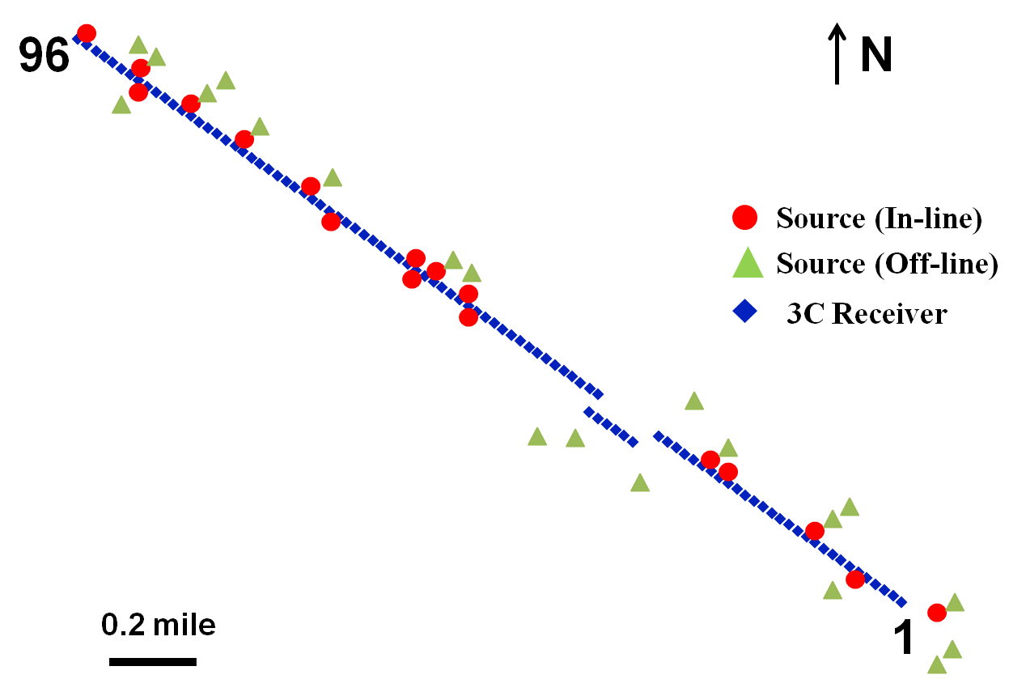
Bradford 3D-3C Seismic Survey
Source: Dynamite
Receiver Interval: 110 ft
(10450 ft)
Data courtesy: GeoKinetics
(0 ft)

Slide 11
Statics: Bradford Survey
NW
P-wave statics
S-wave statics
Statics (ms)
0
2200
4400
6600
8800
Distance (ft)

Slide 12
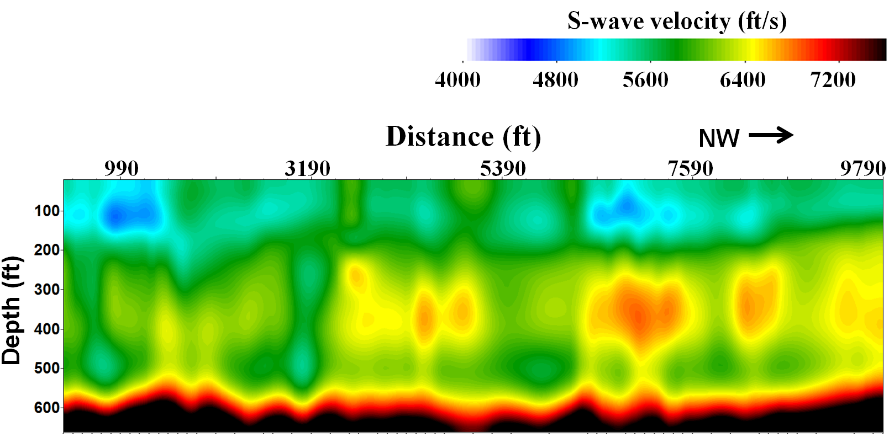
S-wave Velocity: Bradford
z_{w}

Slide 13
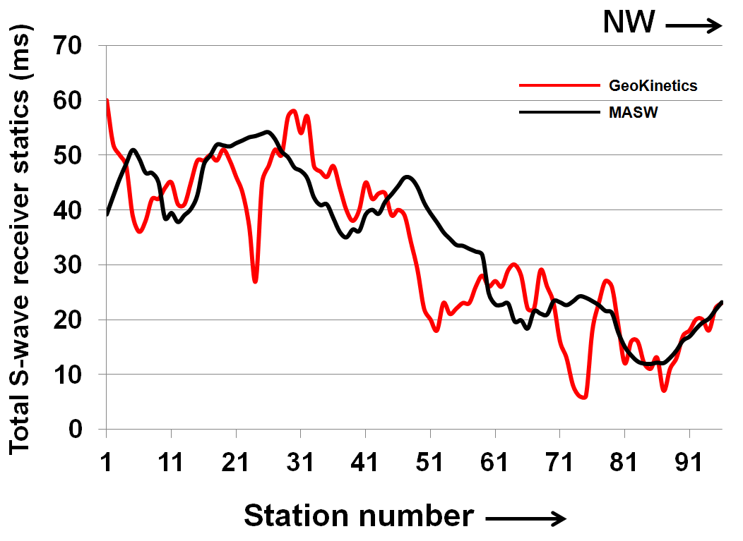
Total S-wave Receiver Statics
0
2200
4400
6600
8800
Distance (ft)

Slide 14
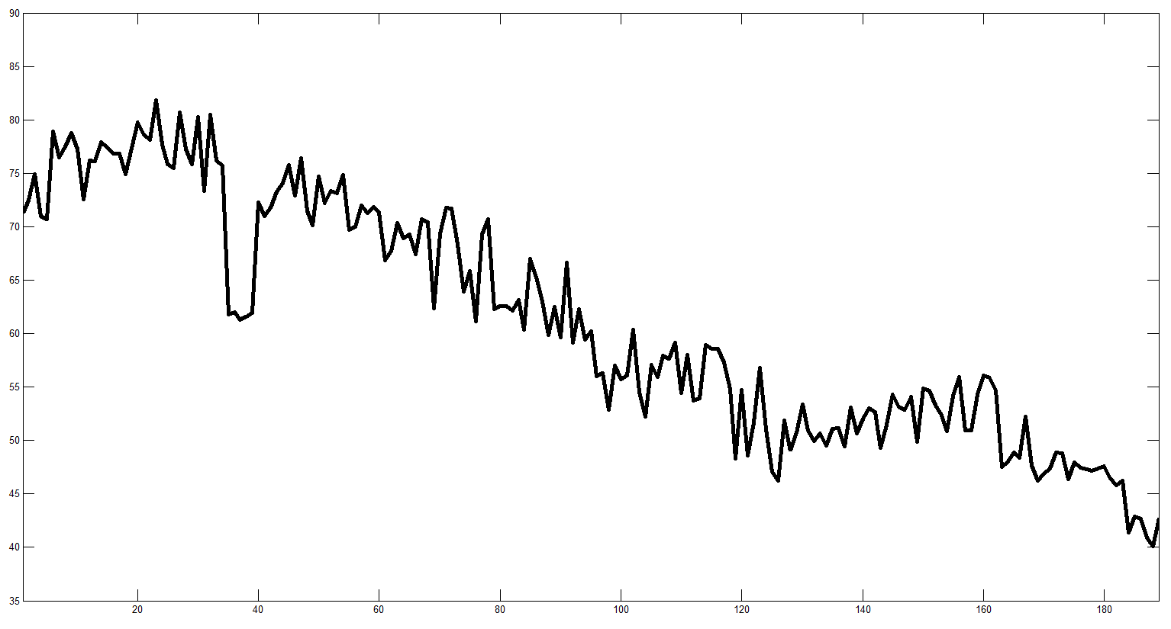
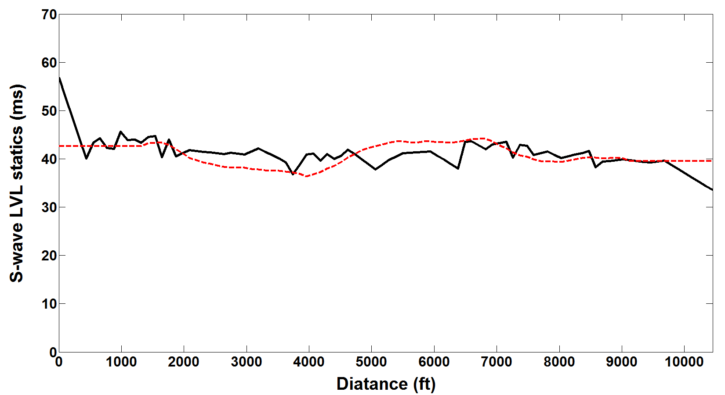
Smooth S-wave LVL Statics
Lack of in-line shots: 2D vs. 3D geometry
Selection of long receiver-spread range
Smooth S-wave statics can be applied at early processing stage
90
Meteor Crater S-wave LVL statics
80
From MASW
70
From GeoKinetics
(Smoothed)
S-wave LVL statics (ms)
60
50
40
Total statics – Elevation statics
36
312
609
Distance (m)

Slide 15
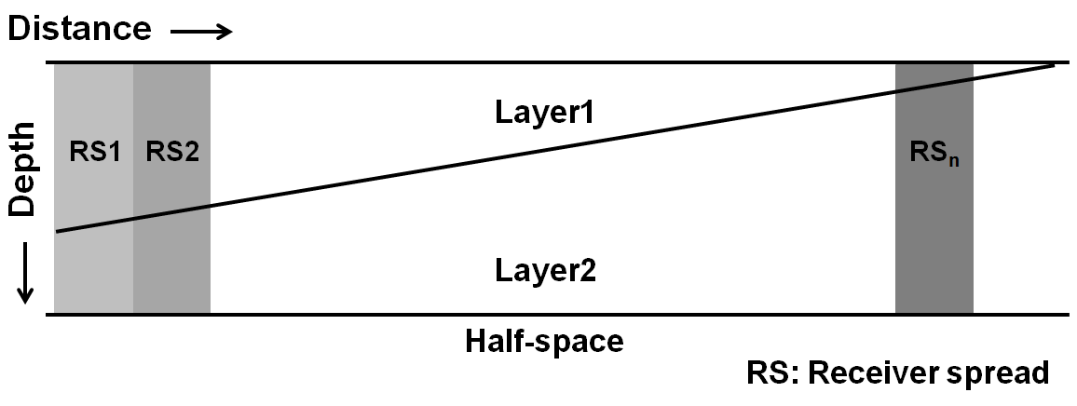
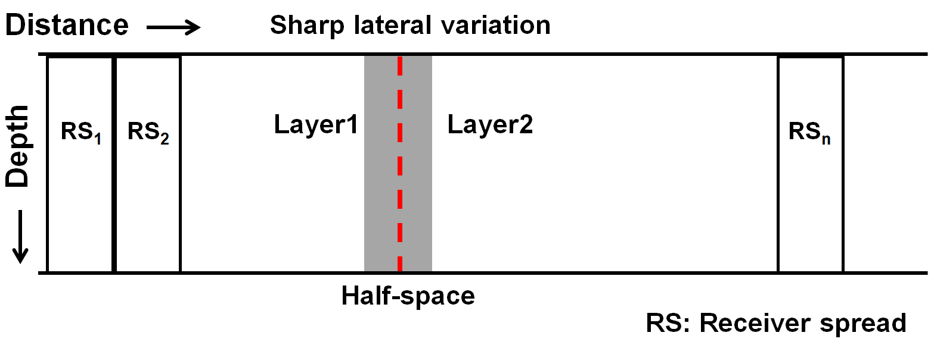
Lateral Heterogeneity and MASW
Gentle lateral variation

Slide 16
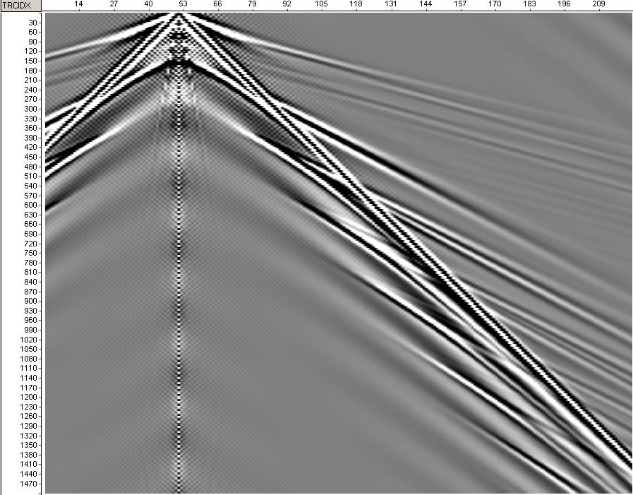
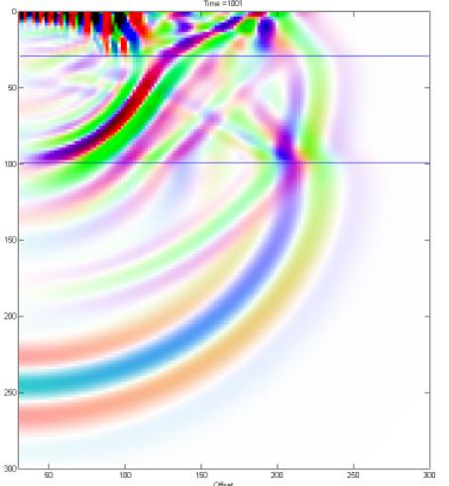
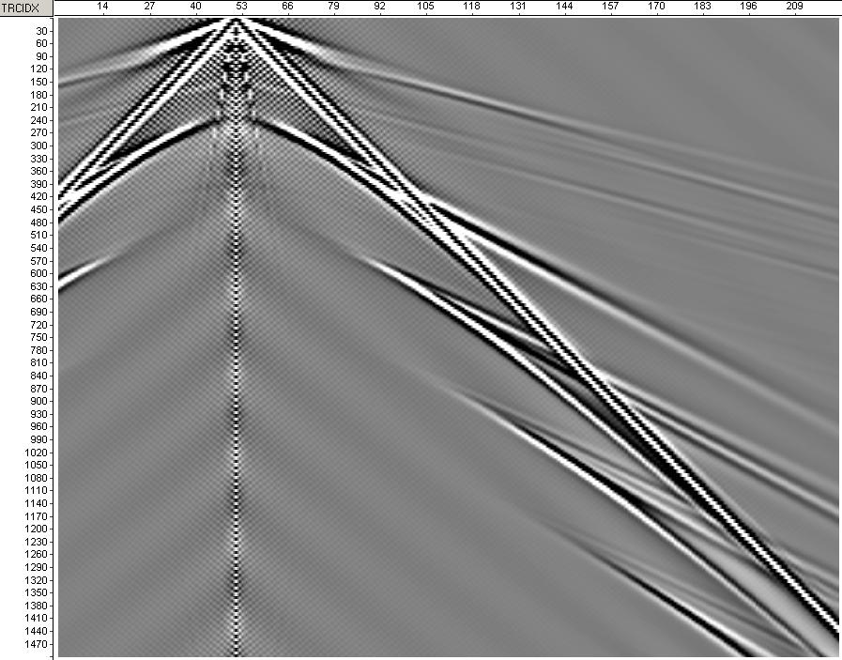
Future Scope: Elastic FWI
V_{P} from refraction analysis
V_{S} from MASW
ρ from well log or predicted
from V_{P} and V_{S}
Offset (m)
Time (ms)
Modeled data
Initial model
Compare modeled and
observed data trace by trace
V_{P1,}Q_{P1,}V_{S1,}Q_{S1,}ρ_{1,}T₁
Offset (m)
V_{P2,}Q_{P2,}V_{S2,}Q_{S2,}ρ_{2,}T₂
Forward Modeling
(ANIVEC; Manning, 2007)
Time (ms)
V_{Pn,}Q_{Pn,}V_{Sn,}Q_{Sn,}ρ_{n}
MATLAB
Observed data
Q : Attenuation
T : Thickness
Inversion and Update model

Slide 17
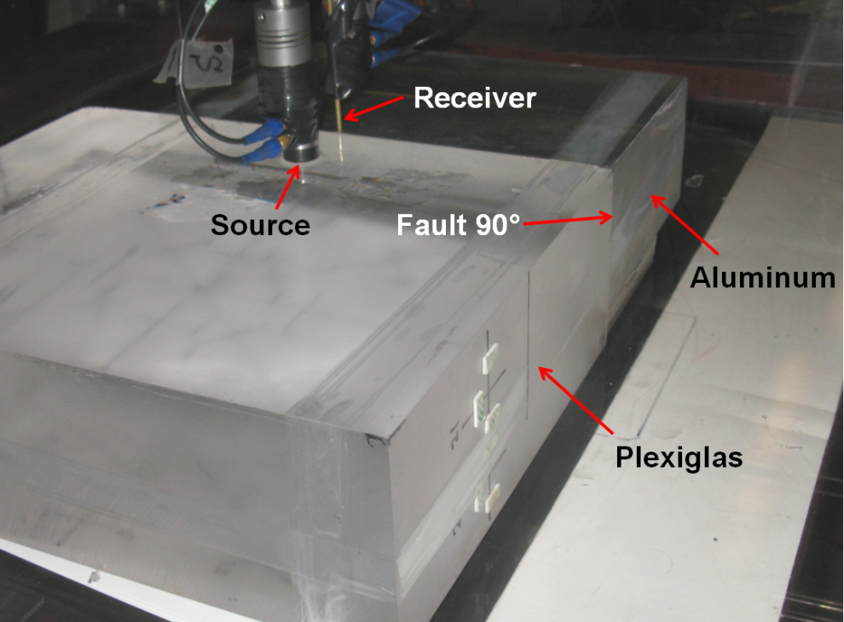
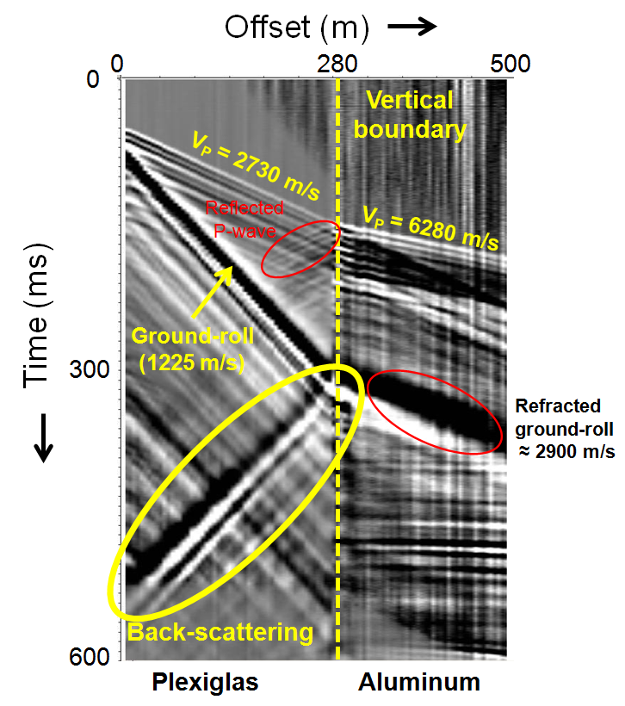
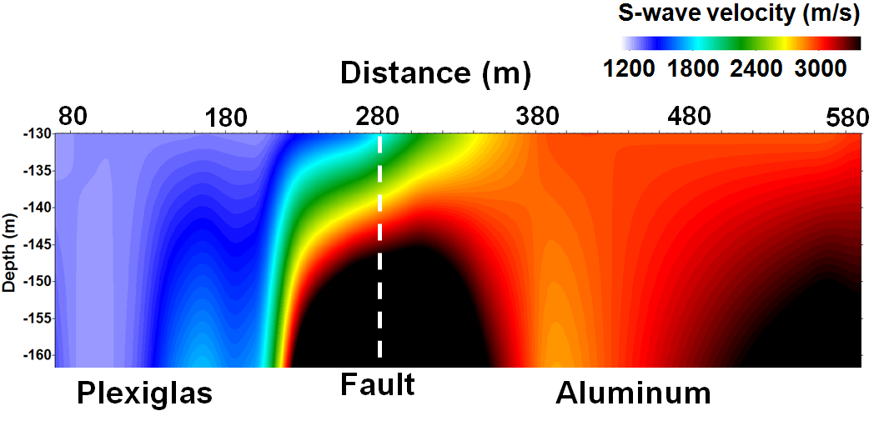
Lateral Heterogeneity (Physical Modeling)

Slide 18
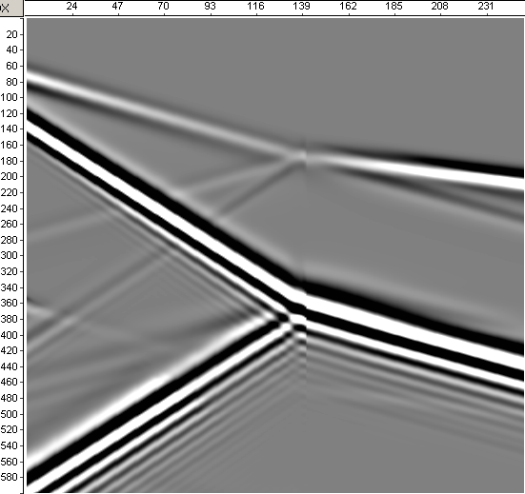
Lateral Heterogeneity (Numerical Modeling)
Distance (m)
120
400
616
Medium 1 (Plexiglas)
Medium 2 (Aluminum)
0
Fault
100
V_{P} = 2740 m/s
V_{S} = 1380 m/s
V_{P} = 6300 m/s
V_{S} = 3100 m/s
200
Time (ms)
300
400
500
Fault
Back-propagated
ground roll
600
Numerical Modeling (Manning, 2007)

Slide 19
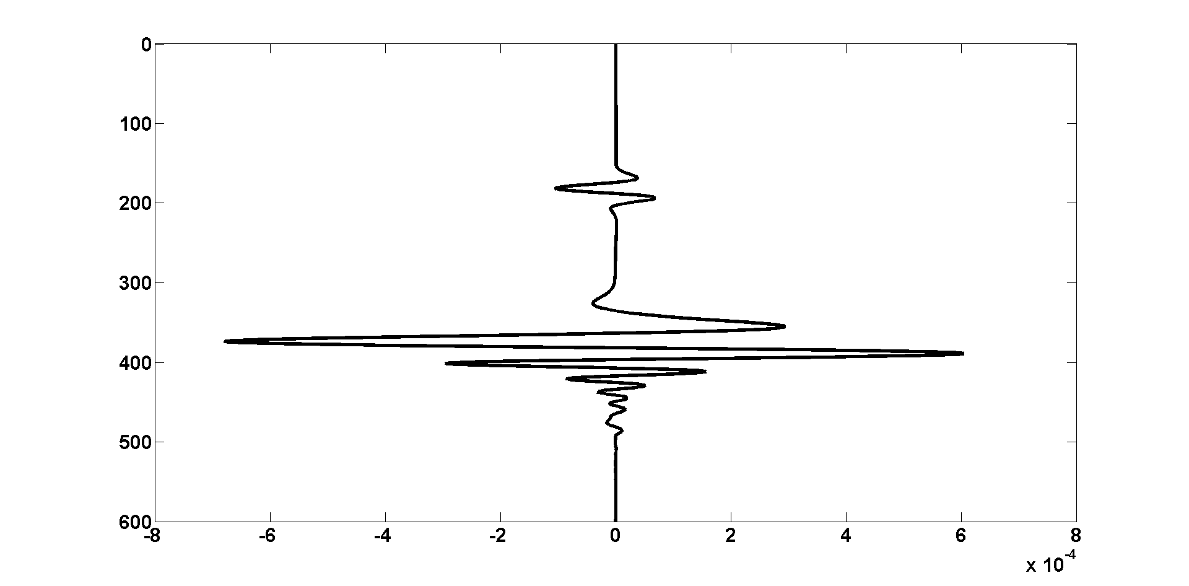
Basic FWI: Lateral Heterogeneity
Far offset trace
Observed
Modeled
0
200
400
600
Time (ms)

Slide 20
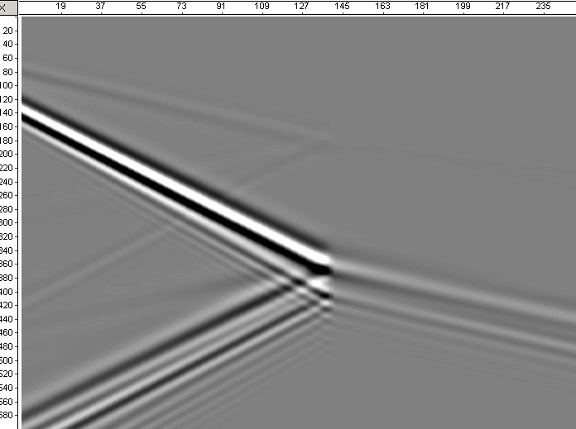
Basic FWI: Lateral Heterogeneity
Distance (m)
120
400
616
0
Observed ~ Modeled
100
Fault
Actual V_{S1} : 1380 m/s
Actual V_{S2} : 3100 m/s
From MASW
Input V_{S1}: 1280 m/s
Input V_{S2} : 2900 m/s
After FWI
Final V_{S1}: 1380.04 m/s
Final V_{S2} : 3101 m/s
200
Time (ms)
300
400
500
600

Slide 21
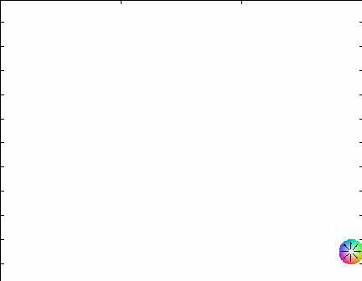
Summary
Near-surface V_{S} values may be very low and variable
V_{S} from MASW provides smooth velocity model
P- and S-wave statics are different
S-wave statics from MASW – a standalone method
Lateral heterogeneity may affect MASW method
FWI - a future step to handle lateral heterogeneity
Distance
Depth

Slide 22
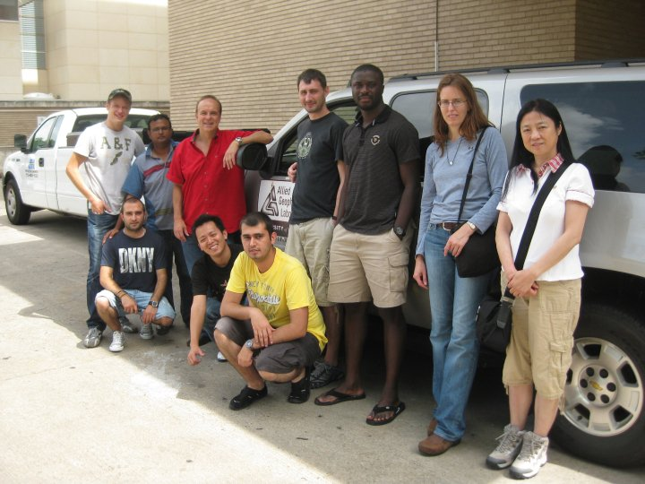
Acknowledgments
Dr. Robert R. Stewart
Mr. Bode Omoboya, Mr. Li Chang, and Mr. Eray Kocel
Dr. Nikolay Dyaur
My friends and colleagues at AGL
GeoKinetics: Mr. Suat Altan
Thank You…
www.agl.uh.edu
Meteor Crater Field Crew (May, 2010)

Slide 24
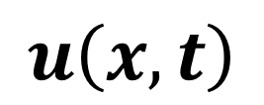

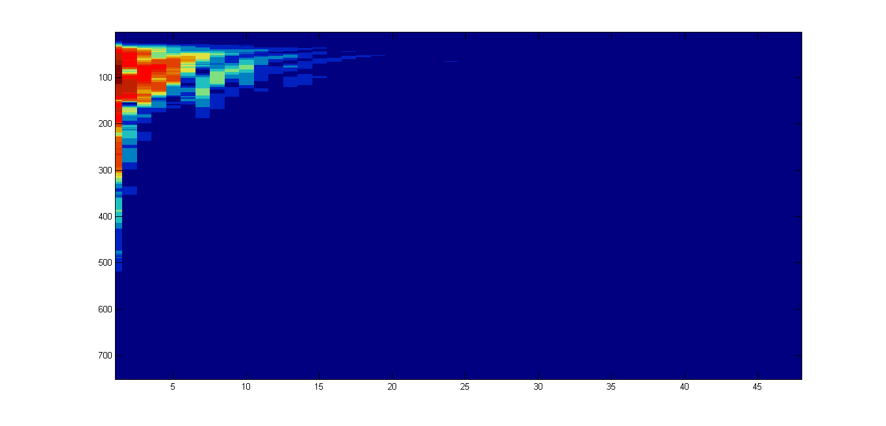
Methodology: MASW
Multichannel Analysis of Surface Waves (MASW)
- Generation of dispersion curves (phase velocity versus frequency plots)
(Park et al., 1998; ibid 1999; Xia et al., 1999)
x
x
Phase
t
f
Amplitude spectra

Slide 25
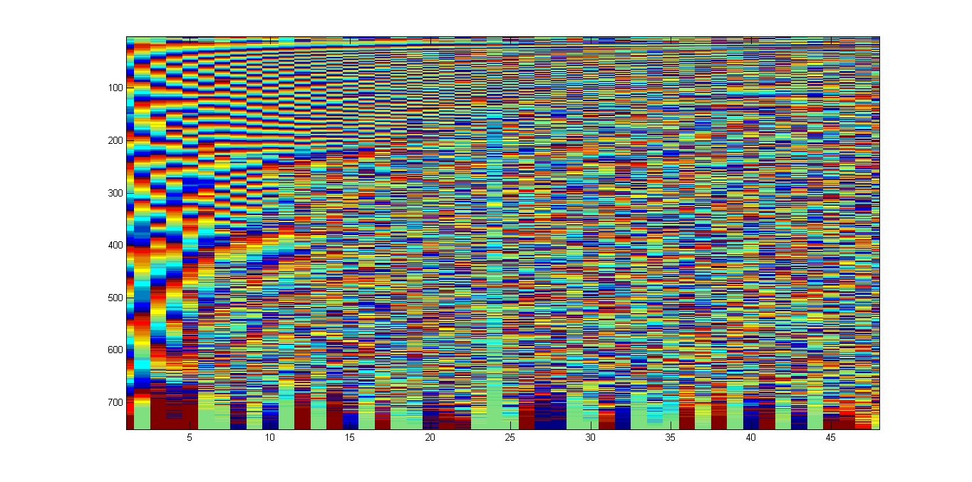

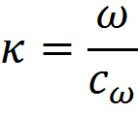

MASW (Dispersion curves)
x
x
*
t
f
Phase spectra
, ω = angular frequency and c_{ω} = phase velocity
Values are stacked over entire offset
The maximum value is obtained when -

Slide 26
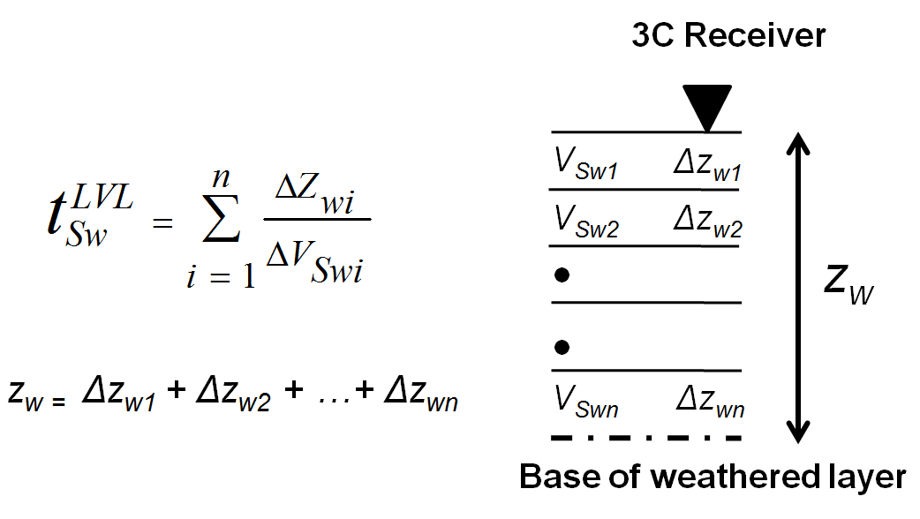
Statics Calculation
Transverse
Radial
Source
Vertical
3C Receiver
Earth surface
Z_{w}
Unconsolidated
sediments
P-wave
S-wave
Base of
low-velocity
layer (LVL)
Consolidated
sediments
P-wave
Base of low-velocity layer (LVL)
S-wave
(Cox, 1999)
Reflector

Slide 27
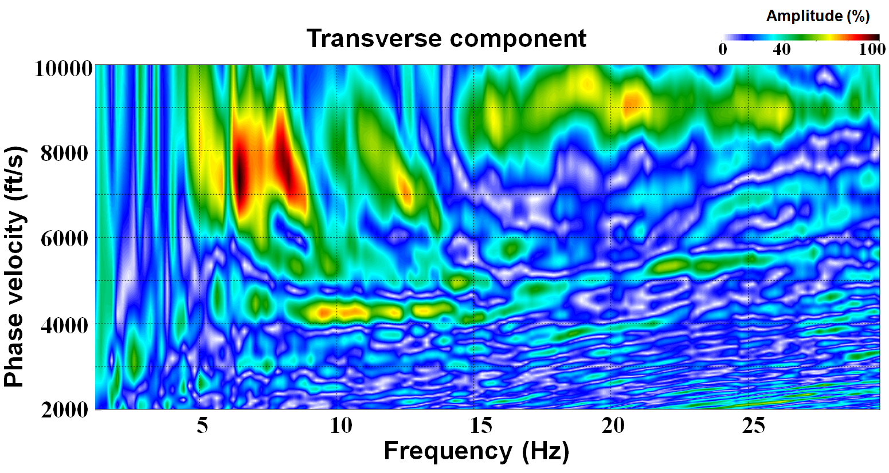
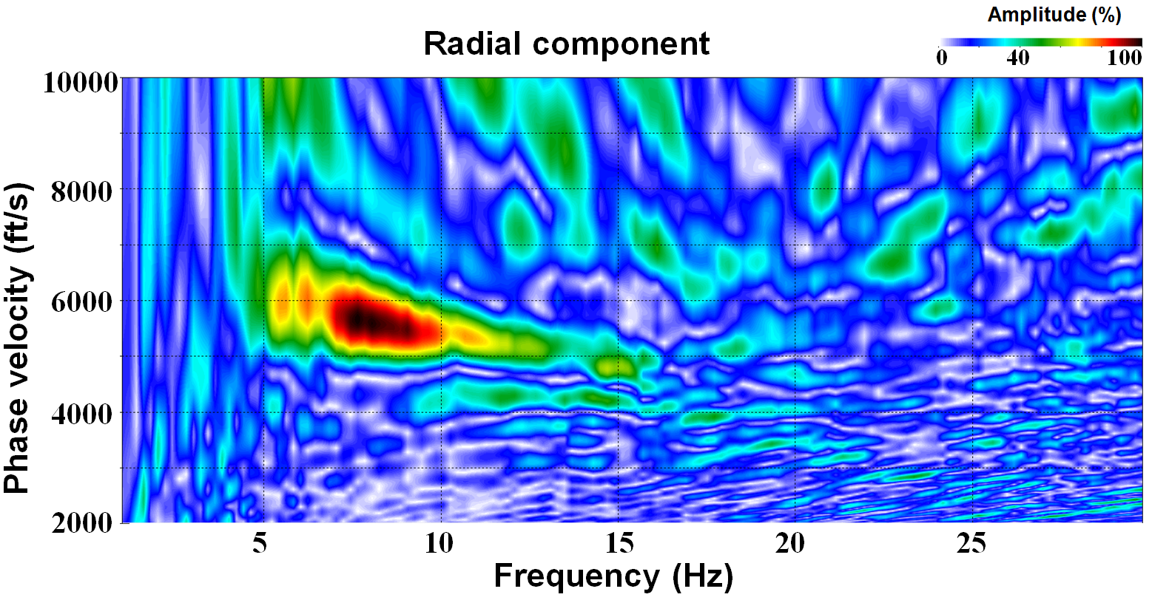
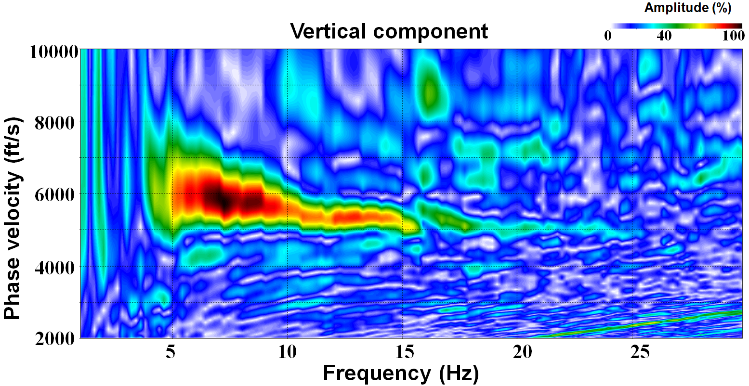
Surface-wave Inversion (MASW)
MASW: Multichannel Analysis of Surface Waves
- Park et al., 1998; Xia et al., 1999
Dispersion curve for one shot gather

Slide 28
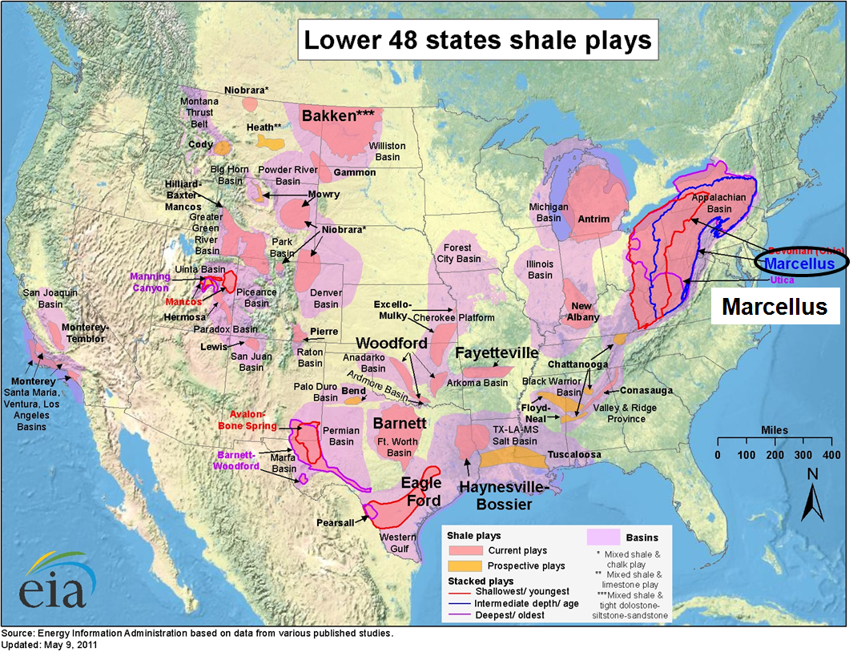
Bradford: Marcellus Shale Case

Slide 29
Basic FWI: Lateral Heterogeneity
Near offset trace
Observed
Modeled
0
200
400
600
Time (ms)

